Slide 1
Anomaly Detection for Denial of Service Attacks
By: Andrew jones

Slide 2




Dataset
NSL-KDD dataset for network intrusion detection
Dataset was created by the MIT Lincoln lab under contract to DARPA on a U.S. Air Force base network
Network Attack Types
Our Focus
Denial of Service
Probe
Remote to User
Root Admin Privileges

Slide 3


Denial of Service Attacks
“Cyber attack in which the perpetrator seeks to make a machine or network resource unavailable to the intended users by temporarily or indefinitely disrupting services of a host connected to the internet”
Very common type of attack in general and the most popular within our dataset
Sophistication has increased into using Distributed Denial of Service Attacks (DDOS) using cloud computing resources to scale up the outbound signal
Notes:
Mention famous DOS Attacks – DYN, brought down the DNS Infrastructure of DYN a major internet performance management firm. Major sites like Github, Spotify and Twitter were down for hours

Slide 4


Key Attack Types detected (All DOS)
Neptune
Neptune – create too many partially open connections
Smurf – uses intermediary broadcaster to amplify packets quantity
Back – submit URL with many front-slashes to apache web server
Land – send a spoofed packet with equal source & destination addresses
Teardrop – sending mangled IP fragments with overlapping payloads
Apache2 – sends request to apache server with many http headers
Udpstorm – floods target with User Datagram Protocol (UDP) packets
Processtable – fill targets process table with multiple instantiations of servers
*bold = attack type not in training set
Earth

Slide 5
Problem Definition
Can we correctly identify Denial of Service Attacks by features included in the interaction on the network?

Slide 6
Data Manipulation Procedures
Dataset was already split into testing and training sets
Transformed the Attack_Types target variable as “1” for DOS attacks & “0” for everything else including other attack types and normal traffic
Chose to use one hot encoding (pd.get_dummies) to handle the 3 categorical features
After using One Hot Encoding, still had to eliminate some features which were not available in both the given test and training sets, or that produced too many features (80+)

Slide 7
Data Dictionary (key features)
Field | Description
Flag | Status of connection as normal or flagged
Service Serror Rate | The % of connections that have an active flag among the aggregated connections
Destination Host Same Service Rate | The % of connections that were to the same service among the aggregated connections
Count | Number of connections to the same destination host as the current connection
Destination Host Service Serror Rate | The % of connections that have activated the flag among the aggregated connections
Destination Bytes | Number of bytes transferred from destination to source in a single connection
Source Bytes | Number of bytes transferred from source to destination in a single connection
Different Service Rate | The % of connections that were to different services
Source Count | The number of connections to the same service (port #) in the past two seconds

Slide 8
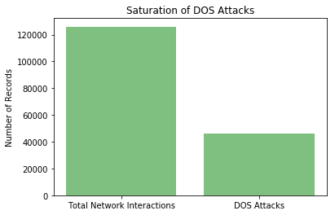
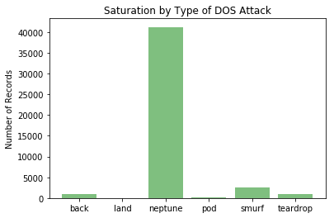
Exploratory Data Analysis
How saturated is the dataset with Dos Attacks?
How are the different types of dos attacks distributed?

Slide 9

Training
Variety of hyper-parameters and features were tested such as:
max_features
max_depth
n_estimators
Feature selection (top 10 /42)
from sklearn import tree
from sklearn.ensemble import RandomForestClassifier
from sklearn.ensemble import ExtraTreesClassifier
from sklearn.ensemble import GradientBoostingClassifier

Slide 10
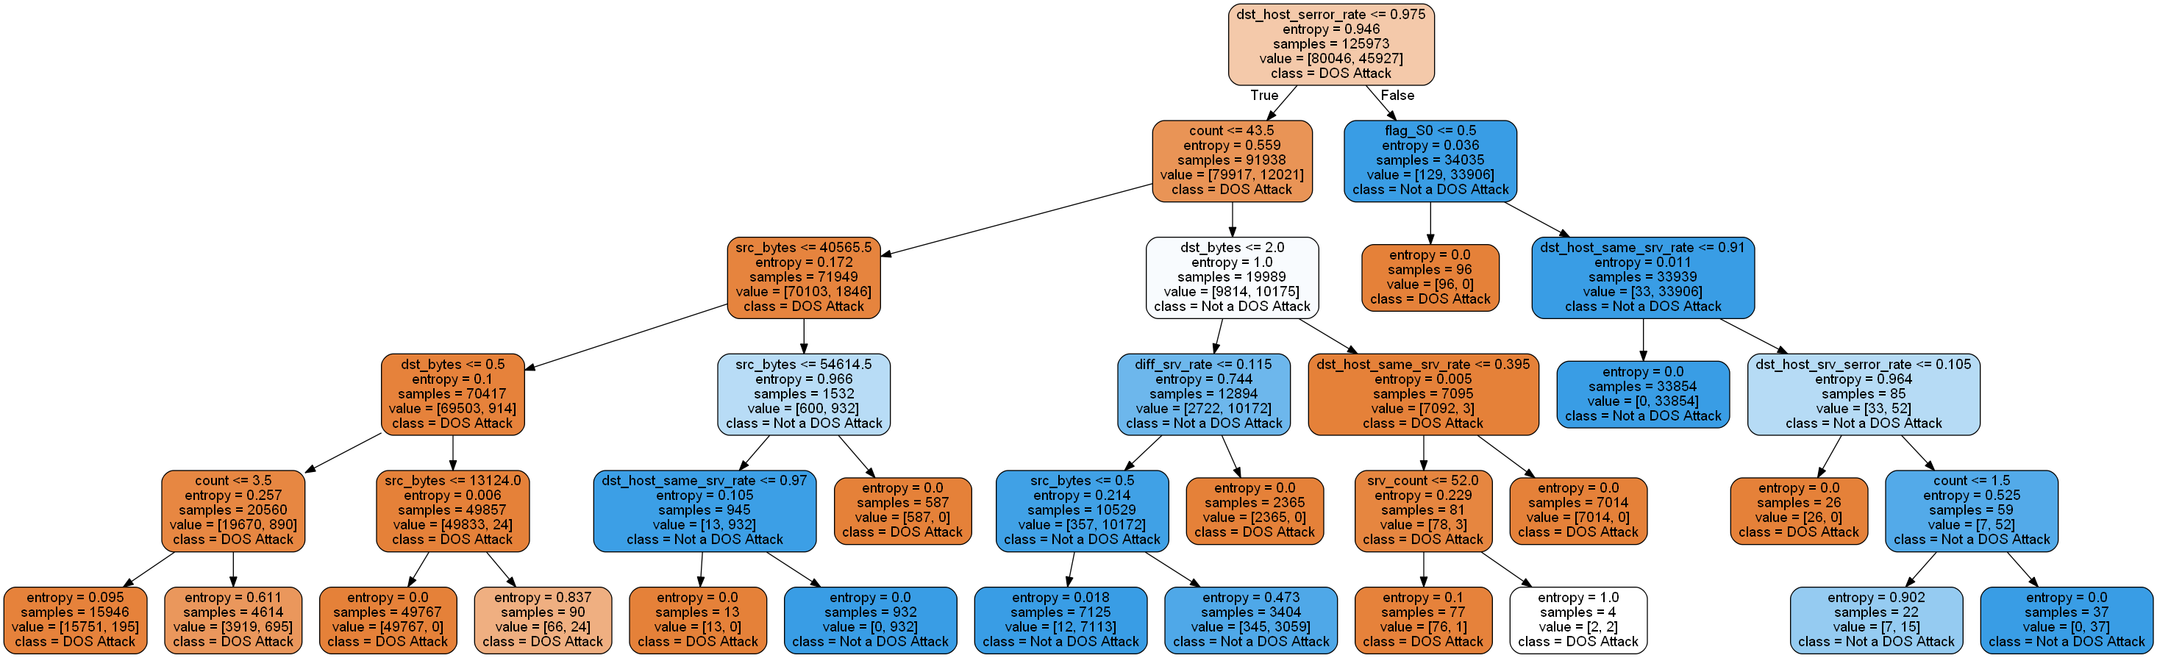
Resulting One Tree Example (entropy)

Slide 11
Decision Tree Results
Entropy
Gini
 | Predicted DOS Attack | Predicted Not a DOS Attack
DOS attack | 5751 | 1416
Not a DOS attack | 191 | 15185
Accuracy | 92.87%
 | Predicted DOS Attack | Predicted Not a DOS Attack
DOS attack | 5699 | 1468
Not a DOS attack | 329 | 15047
Accuracy | 92.03%

Slide 12

Random Forest Results
Entropy
Gini
 | Predicted DOS Attack | Predicted Not a DOS Attack
DOS attack | 5861 | 1306
Not a DOS attack | 219 | 15157
Accuracy | 93.24%
 | Predicted DOS Attack | Predicted Not a DOS Attack
DOS attack | 5790 | 1377
Not a DOS attack | 197 | 15179
Accuracy | 93.02%

Slide 13
Extra Random Forest Results
Gini
 | Predicted DOS Attack | Predicted Not a DOS Attack
DOS attack | 5762 | 1405
Not a DOS attack | 229 | 15147
Accuracy | 92.75%

Slide 14
Gradient Boosting Results
Gini
 | Predicted DOS Attack | Predicted Not a DOS Attack
DOS attack | 5793 | 1374
Not a DOS attack | 236 | 15140
Accuracy | 92.85%
Only marginal improvements obtained via different methods & criterions

Slide 15




Detection System Shortcomings
Inherent Low Generalizability – networks have many different traffic pattern types depending on their purpose
Training / Response Time – many more advanced network intrusion algorithms can be computationally expensive
Feature Extraction and Consistency – different server types & ages can have different extracts that have to be configured to match the algorithms training procedures
Technology Progression – obviously training on historical data is unlikely to pick up new attack vectors which are constantly created
Notes:
Low Generalizability – this means that any model is best trained on the network that it will be deployed on
Training Time – you sometimes have to make a tradeoff between accuracy and response time. If accuracy is of the utmost importance, the response time can be longer. If accuracy is not the highest priority because the network has relatively unsensitive data, then it may be too inconvenient for the vast majority of non-harmful users to interact
Technology Progression – at one point basically by accident I encoded the Testing set so that the attacks only have the same attacks as the test set. The accuracy of that model was almost perfect. This further showcases this point. It would be best to have domain experts to help configure features for reasons that may not show in the data.

Slide 16
Sources
Data Source - https://github.com/defcom17/NSL_KDD
Data Dictionary- https://pdfs.semanticscholar.org/1b34/80021c4ab0f632efa99e01a9b073903c5554.pdf?_ga=2.265703823.103867871.1500221431-557851010.1499886538
Attack Types - https://www.ll.mit.edu/ideval/docs/attackDB.html

